Slide 1
Hackathon
Project on
HealthFit
Team Aspirants:
Prudhvi raj
Sohel shaik
Narashimha

Slide 2
Index
INTRODUCTION
ABOUT
DIETS
FOOD
SUMMARY
BIBLIOGRAPHY

Slide 3
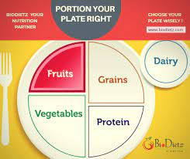
INTRODUCTION
HealthFit Basically comes up with Diet plan depending upon the weight of the person(if he or she enters the weight for that particular weight healthy diet plan will be showed)

Slide 4
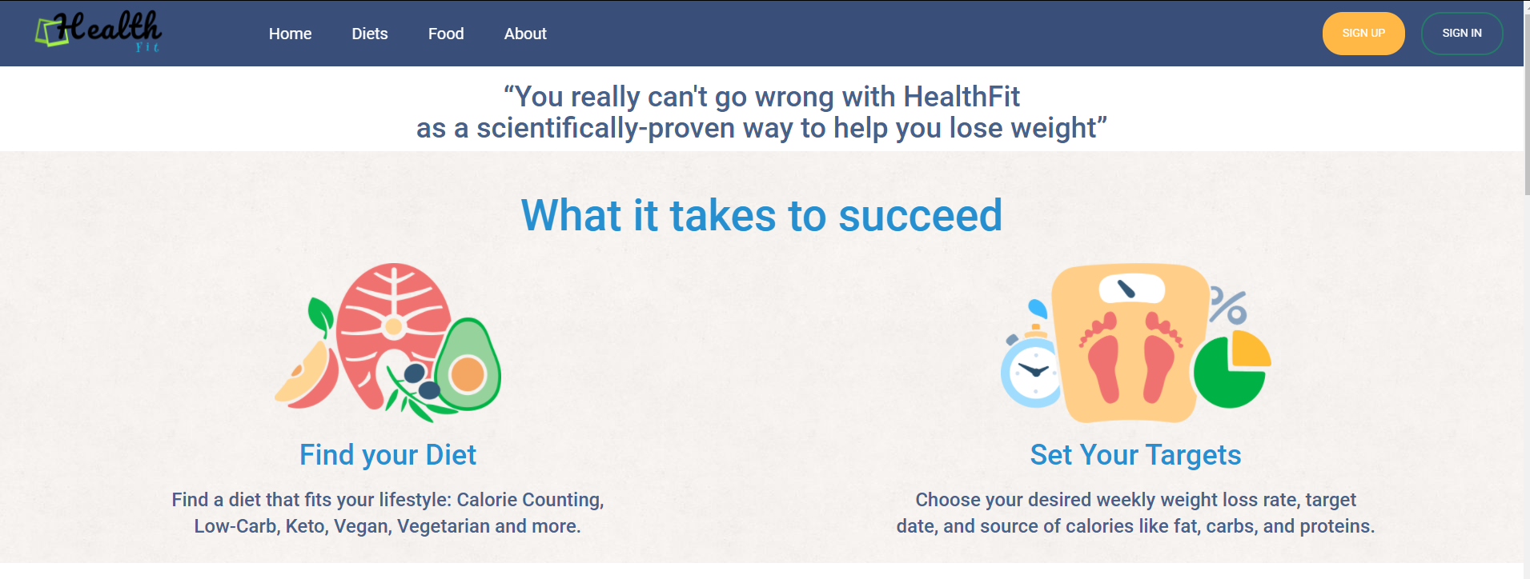
ABOUT
To loose weight we as a HealthFit members come up wonderful diet plan that eventually choose your everyday lifestyle
In HealthFit anyone can setup the targets to loose weight depending upon the target and weight of the person the diet plan is showed
HealthFit is only the platform provides individual diet and our team is more concerned about the diet that we are providing are referred by top diet planners

Slide 5
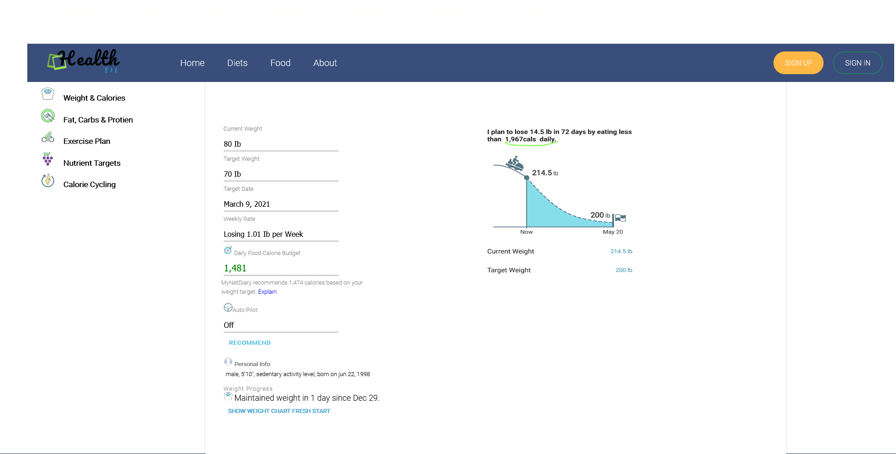
Diet
HealthFit is most concerned about Customer Healthy diet plan
Initially we gather information from the user about his or her current weight and targeted weight along with targeted date (to loose or gain weight)
HealthFit provides weekly monitoring about loosing or gaining of weight and amount to be spent to gain certain number calories daily
Finally it also provides graph with were user can personally monitor day to day loosing of weight with proper food

Slide 6
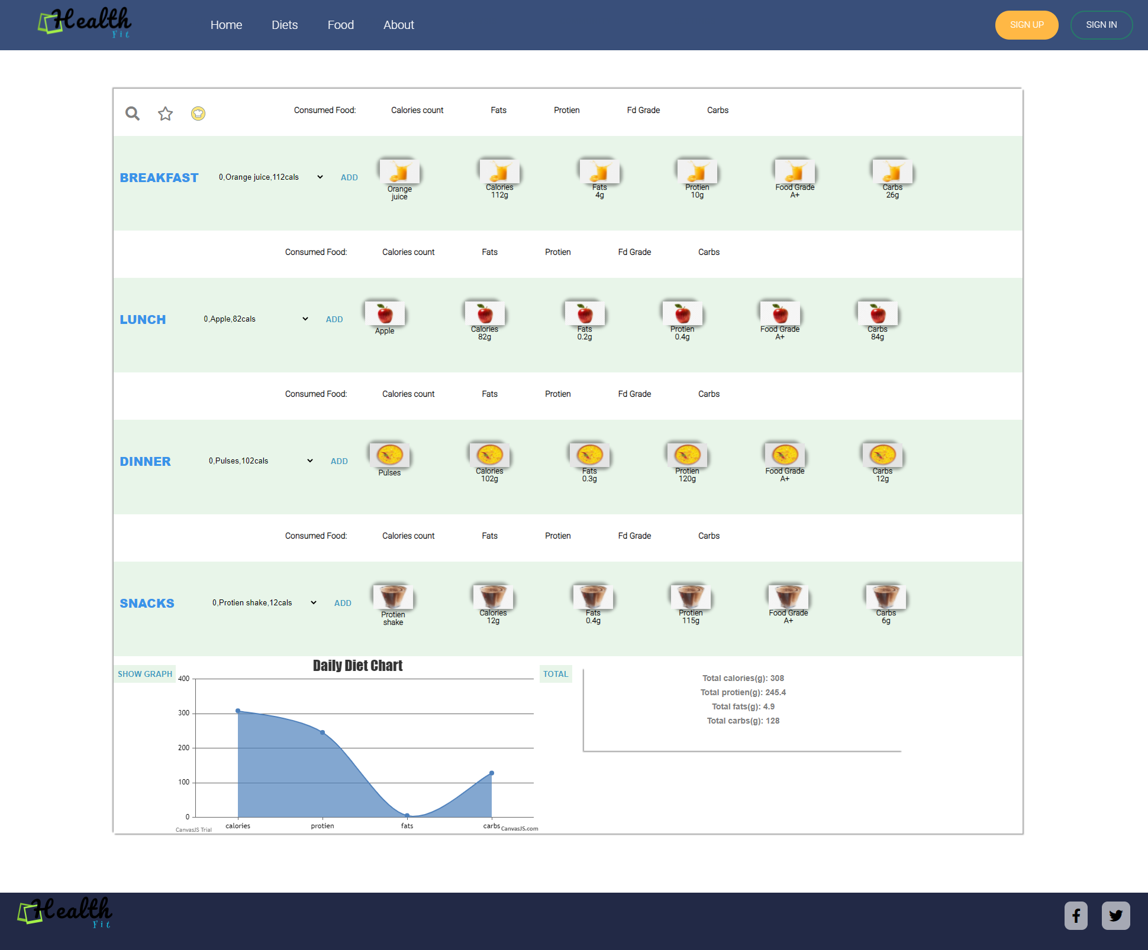
Food
HealthFit is most concerned about food that user consuming daily
We HealthFit members tried very hard to provide healthy diet plan Depending upon person to person weights and health conditions
If any user is suffering from any health issues like diabaties even in that case our Dieticians provide proper diet plan that doesn’t anyones health

Slide 7

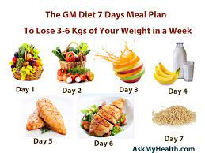
SUMMARY
To Summarize HealthFit is also challenging 7 day Diet plan which eventually reduces approx. of 3-5 kgs with in a week
HealthFit is a non-profit organization we are the members in HealthFit are mostly concerned about user healthy Diet plan
We are the first among all Diet planning organizations to provide 7-day meal plan which incorporate any health issue even though user is eligible to follow this diet as mentioned

Slide 8
BIBLIOGRAPHY
https://www.ncbi.nlm.nih.gov/books/NBK221366/
https://www.healthline.com/nutrition/best-diet-plans

